Slide 1





?
an intro for geeks who already know
a thing or two about functional programming
presented by Bryan Hunter Firefly Logic
Twitter #erlang
@bryan_hunter
@fireflylogic

Slide 2
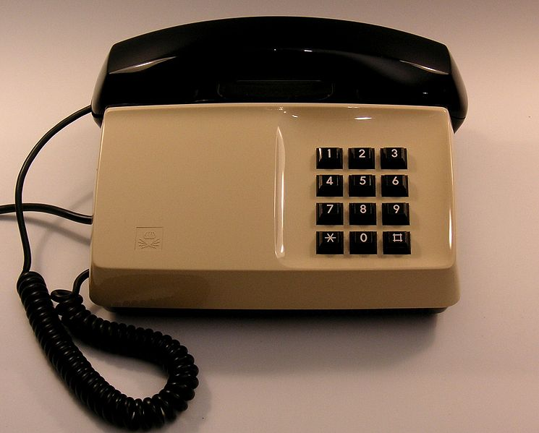
Why?

Slide 3
“Erlang is a programming language used to build
massively scalable
soft real-time systems
with requirements on high availability”
-from www.erlang.org

Slide 4

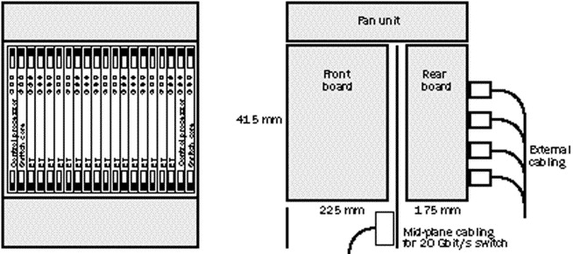
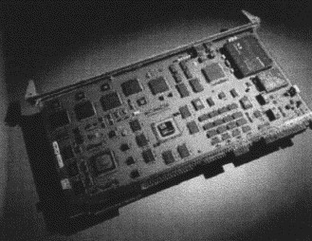
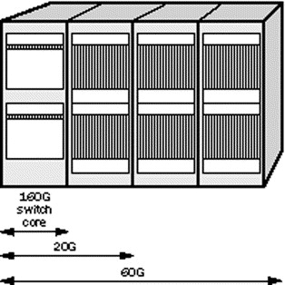
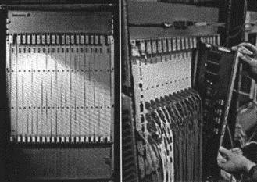

Slide 5



Joe
Mike
Robert
THE MOVIE

Slide 6
Erlang.
What exactly is Erlang?
Why Erlang?
How do you do it?
Erlang (the language)
+ OTP (libraries, pattern implementations)
+ ERTS (Erlang Runtime System)

Slide 7
Erlang (the Language)
Functional
immutability, higher-order functions, referential transparency, separation of behavior and data, recursion,
Concurrency- oriented
Different model of the world
Prolog roots
Pattern matching

Slide 8
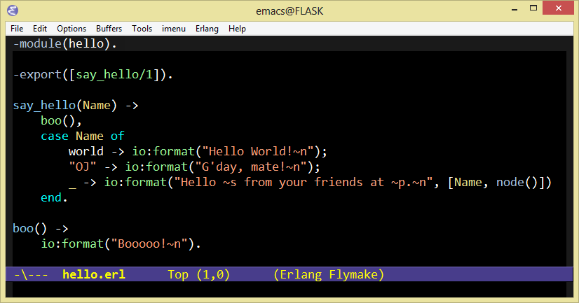
Erlang (the Language)

Slide 9
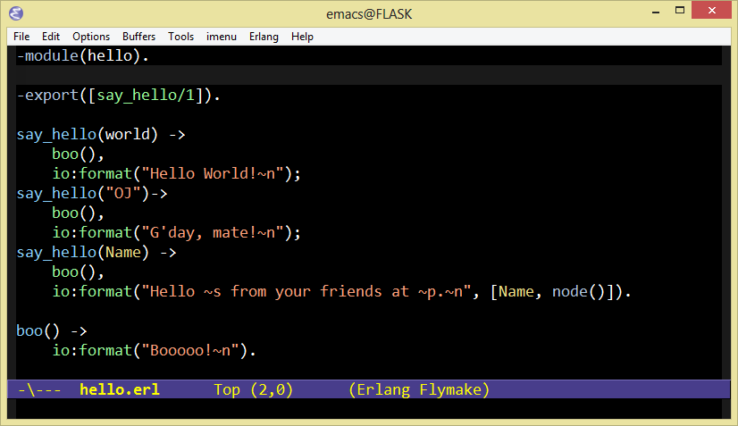
Erlang (the Language)

Slide 10
Erlang OTP
Libraries and design principles
Middle-ware
A distributed database
Applications to interface other languages
Debugging
Release handling tools.

Slide 11
Erlang Runtime System
A special purpose operating system built for
Concurrency via “processes”
Distribution across “nodes”
Fault tolerance

Slide 12
Erlang?
What exactly is Erlang?
Why Erlang?
How do you do it?
My Twitter answer:
Erlang is open, proven and cross-platform. It simplifies writing reliable, concurrent, distributed systems. Its pattern matching is FTW.

Slide 13
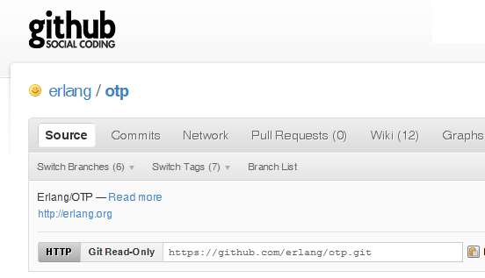

Why -> Erlang is open

Slide 14
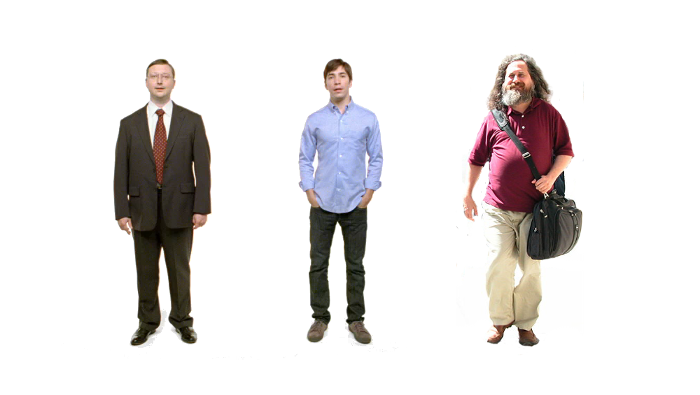

Erlang
Erlang
Erlang
Erlang
ARM
Why -> Erlang is cross-platform

Slide 15















Why -> Erlang is proven

Slide 16
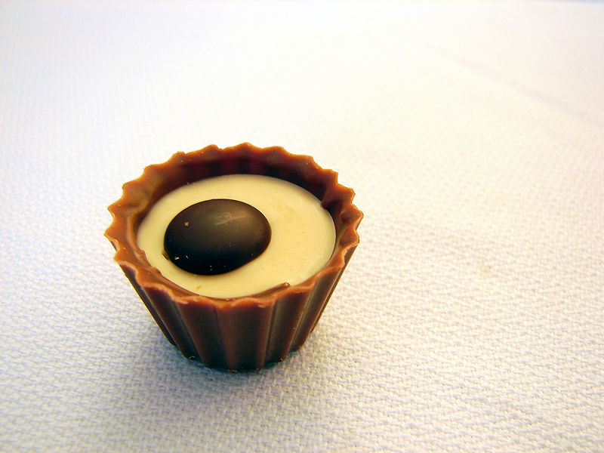
What are the sweet spots?

Slide 17
Two thing to remember about
Concurrency
1) Shared memory concurrency is hard
2) Message passing concurrency is easy

Slide 18
Erlang Processes
are the unit of concurrency.
You structure your programs around these units of concurrency; a process per concurrent activity

Slide 19
“The performance
of a concurrent language
is predicated by three things:
the context switching time,
The message passing time,
and the time to create a process.”
–Mike Williams

Slide 20
Erlang Processes are Lightweight
grow and shrink dynamically
small memory footprint
fast to create and terminate
scheduling overhead is low

Slide 21
One .NET 4.0 Thread (allocates one megabyte)
**********
**********
**********
**********
**********
**********
**********
**********
**********
**********
**********
**********
**********
**********
**********
**********
**********
**********
**********
**********
**********
**********
**********
**********
**********
**********
**********
**********
**********
**********
**********
**********
**********
**********
**********
**********
**********
**********
**********
**********
**********
**********
**********
**********
**********
**********
**********
**********
**********
**********
Heap
Mailbox
Stack
**********
**********
**********
**********
**********
**********
**********
**********
**********
**********
**********
**********
**********
**********
**********
**********
**********
**********
**********
**********
**********
**********
**********
**********
**********
**********
**********
**********
**********
**********
**********
**********
**********
**********
**********
**********
**********
**********
**********
**********
**********
**********
**********
**********
**********
**********
**********
**********
**********
**********
Garbage Collector
Links and Monitors
One Erlang Process (allocates one kilobyte)
*

Slide 22
*
*
*
Reductions
- Do 2,000 operations
reduction1 reduction3 .
Reduction2000
- Move to the next guy - Repeat
CPU Core

Slide 23
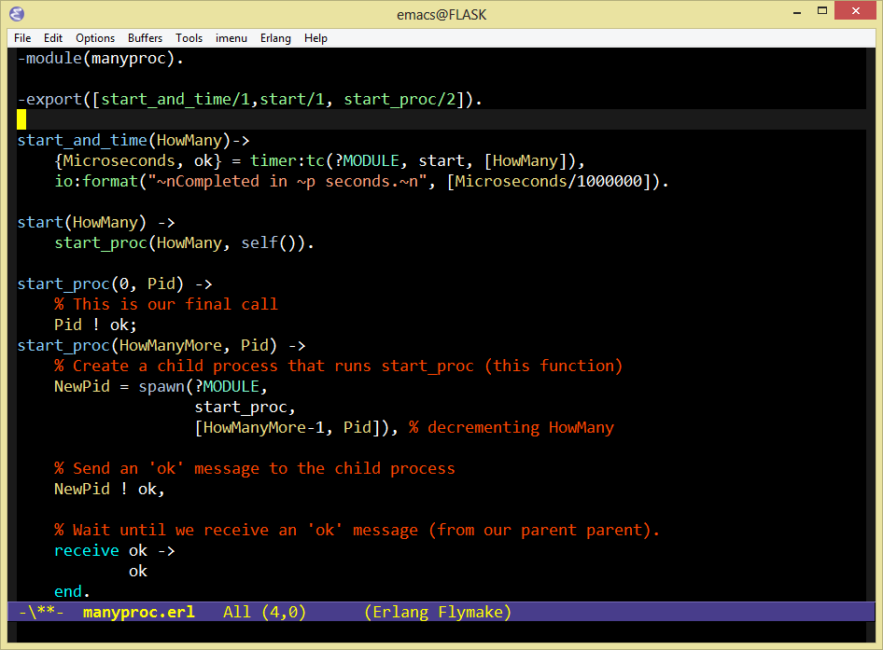

Slide 24
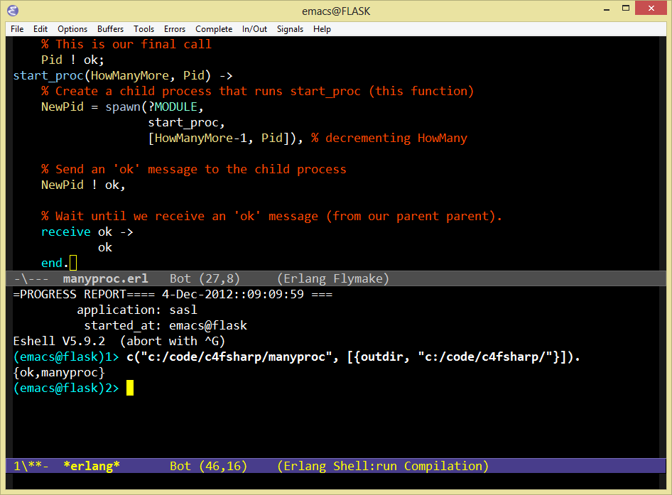

Slide 25
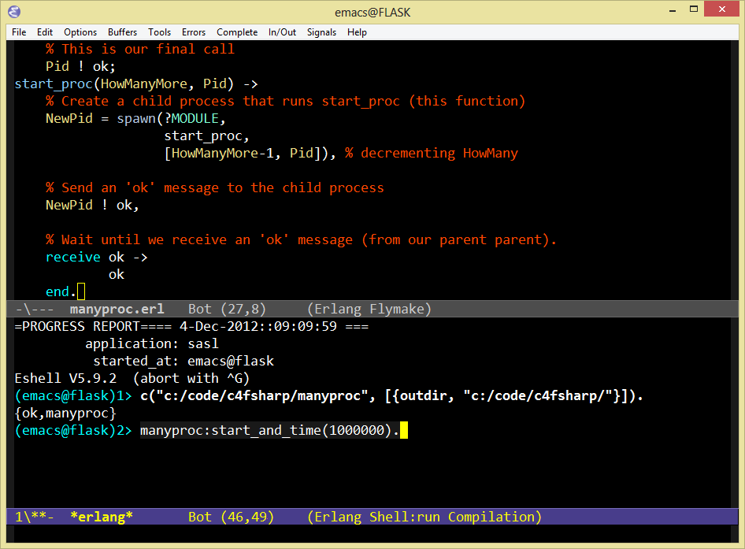

Slide 26
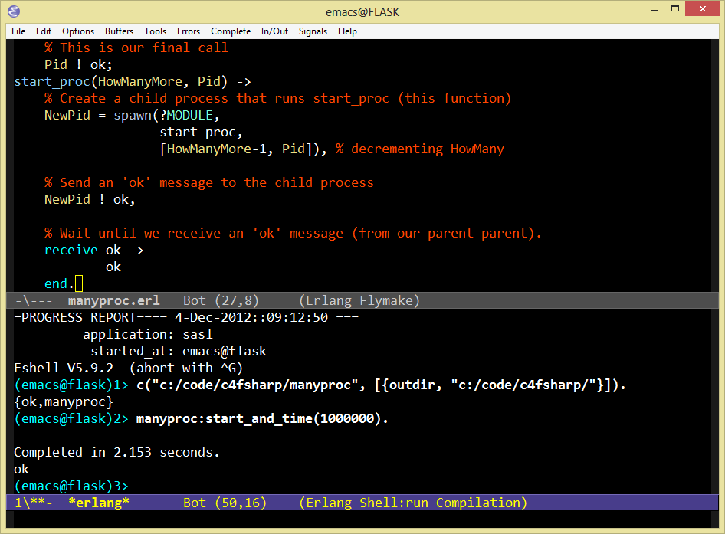
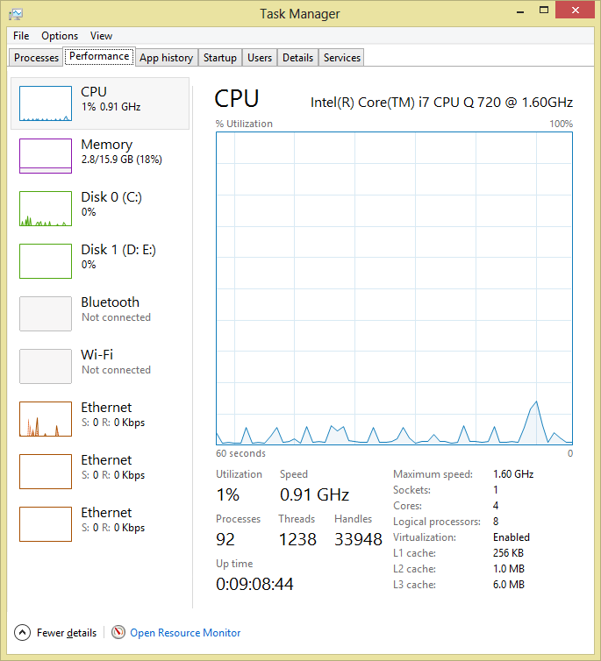

Slide 27
***** *****
***** *****
***** *****
***** *****
Core
Core
Core
Core

Slide 28




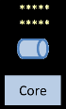
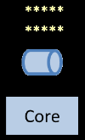
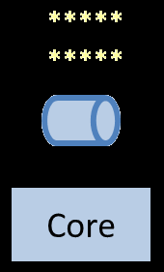
Distribution: built-in from the start

Slide 29
Erlang R15B02 (erts-5.9.2) [64-bit] [smp:8:8] [async-threads:0]
Eshell V5.9.2 (abort with ^G)
(bird@flask)1>
Eshell V5.9.2 (abort with ^G)
(cat@flask)1>
Erlang R15B02 (erts-5.9.2) [64-bit] [smp:8:8] [async-threads:0]
Eshell V5.9.2 (abort with ^G)
(dog@flask)1>

Slide 30
Erlang R15B02 (erts-5.9.2) [64-bit] [smp:8:8] [async-threads:0]
Eshell V5.9.2 (abort with ^G)
(bird@flask)1>
Eshell V5.9.2 (abort with ^G)
(cat@flask)1> nodes().
[]
(cat@flask)2>
Erlang R15B02 (erts-5.9.2) [64-bit] [smp:8:8] [async-threads:0]
Eshell V5.9.2 (abort with ^G)
(dog@flask)1>

Slide 31
Erlang R15B02 (erts-5.9.2) [64-bit] [smp:8:8] [async-threads:0]
Eshell V5.9.2 (abort with ^G)
(bird@flask)1>
Eshell V5.9.2 (abort with ^G)
(cat@flask)1> nodes().
[]
(cat@flask)2>
Erlang R15B02 (erts-5.9.2) [64-bit] [smp:8:8] [async-threads:0]
Eshell V5.9.2 (abort with ^G)
(dog@flask)1> nodes().
[]
(dog@flask)2>

Slide 32
Erlang R15B02 (erts-5.9.2) [64-bit] [smp:8:8] [async-threads:0]
Eshell V5.9.2 (abort with ^G)
(bird@flask)1>
Eshell V5.9.2 (abort with ^G)
(cat@flask)1> nodes().
[]
(cat@flask)2> net_adm:ping(bird@flask).
pong
(cat@flask)3>
Erlang R15B02 (erts-5.9.2) [64-bit] [smp:8:8] [async-threads:0]
Eshell V5.9.2 (abort with ^G)
(dog@flask)1> nodes().
[]
(dog@flask)2>

Slide 33
Erlang R15B02 (erts-5.9.2) [64-bit] [smp:8:8] [async-threads:0]
Eshell V5.9.2 (abort with ^G)
(bird@flask)1>
Eshell V5.9.2 (abort with ^G)
(cat@flask)1> nodes().
[]
(cat@flask)2> net_adm:ping(bird@flask).
pong
(cat@flask)3> nodes().
[bird@flask]
(cat@flask)4>
Erlang R15B02 (erts-5.9.2) [64-bit] [smp:8:8] [async-threads:0]
Eshell V5.9.2 (abort with ^G)
(dog@flask)1> nodes().
[]
(dog@flask)2>

Slide 34
Erlang R15B02 (erts-5.9.2) [64-bit] [smp:8:8] [async-threads:0]
Eshell V5.9.2 (abort with ^G)
(bird@flask)1> nodes().
[cat@flask]
(bird@flask)2>
Eshell V5.9.2 (abort with ^G)
(cat@flask)1> nodes().
[]
(cat@flask)2> net_adm:ping(bird@flask).
pong
(cat@flask)3> nodes().
[bird@flask]
(cat@flask)4>
Erlang R15B02 (erts-5.9.2) [64-bit] [smp:8:8] [async-threads:0]
Eshell V5.9.2 (abort with ^G)
(dog@flask)1> nodes().
[]
(dog@flask)2>

Slide 35
Erlang R15B02 (erts-5.9.2) [64-bit] [smp:8:8] [async-threads:0]
Eshell V5.9.2 (abort with ^G)
(bird@flask)1> nodes().
[cat@flask]
(bird@flask)2>
Eshell V5.9.2 (abort with ^G)
(cat@flask)1> nodes().
[]
(cat@flask)2> net_adm:ping(bird@flask).
pong
(cat@flask)3> nodes().
[bird@flask]
(cat@flask)4>
Erlang R15B02 (erts-5.9.2) [64-bit] [smp:8:8] [async-threads:0]
Eshell V5.9.2 (abort with ^G)
(dog@flask)1> nodes().
[]
(dog@flask)2> net_adm:ping(cat@flask).
pong
(dog@flask)3>

Slide 36
Erlang R15B02 (erts-5.9.2) [64-bit] [smp:8:8] [async-threads:0]
Eshell V5.9.2 (abort with ^G)
(bird@flask)1> nodes().
[cat@flask]
(bird@flask)2>
Eshell V5.9.2 (abort with ^G)
(cat@flask)1> nodes().
[]
(cat@flask)2> net_adm:ping(bird@flask).
pong
(cat@flask)3> nodes().
[bird@flask]
(cat@flask)4>
Erlang R15B02 (erts-5.9.2) [64-bit] [smp:8:8] [async-threads:0]
Eshell V5.9.2 (abort with ^G)
(dog@flask)1> nodes().
[]
(dog@flask)2> net_adm:ping(cat@flask).
pong
(dog@flask)3> nodes().
[cat@flask,bird@flask]
(dog@flask)4>

Slide 37
Erlang R15B02 (erts-5.9.2) [64-bit] [smp:8:8] [async-threads:0]
Eshell V5.9.2 (abort with ^G)
(bird@flask)1> nodes().
[cat@flask]
(bird@flask)2>
Eshell V5.9.2 (abort with ^G)
(cat@flask)1> nodes().
[]
(cat@flask)2> net_adm:ping(bird@flask).
pong
(cat@flask)3> nodes().
[bird@flask]
(cat@flask)4> nodes().
[bird@flask,dog@flask]
(cat@flask)5>
Erlang R15B02 (erts-5.9.2) [64-bit] [smp:8:8] [async-threads:0]
Eshell V5.9.2 (abort with ^G)
(dog@flask)1> nodes().
[]
(dog@flask)2> net_adm:ping(cat@flask).
pong
(dog@flask)3> nodes().
[cat@flask,bird@flask]
(dog@flask)4>

Slide 38
Erlang R15B02 (erts-5.9.2) [64-bit] [smp:8:8] [async-threads:0]
Eshell V5.9.2 (abort with ^G)
(bird@flask)1> nodes().
[cat@flask]
(bird@flask)2> nodes().
[cat@flask,dog@flask]
(bird@flask)3>
Eshell V5.9.2 (abort with ^G)
(cat@flask)1> nodes().
[]
(cat@flask)2> net_adm:ping(bird@flask).
pong
(cat@flask)3> nodes().
[bird@flask]
(cat@flask)4> nodes().
[bird@flask,dog@flask]
(cat@flask)5>
Erlang R15B02 (erts-5.9.2) [64-bit] [smp:8:8] [async-threads:0]
Eshell V5.9.2 (abort with ^G)
(dog@flask)1> nodes().
[]
(dog@flask)2> net_adm:ping(cat@flask).
pong
(dog@flask)3> nodes().
[cat@flask,bird@flask]
(dog@flask)4>

Slide 39
Erlang R15B02 (erts-5.9.2) [64-bit] [smp:8:8] [async-threads:0]
Eshell V5.9.2 (abort with ^G)
(bird@flask)1> nodes().
[cat@flask]
(bird@flask)2> nodes().
[cat@flask,dog@flask]
(bird@flask)3>
Eshell V5.9.2 (abort with ^G)
(cat@flask)1> nodes().
[]
(cat@flask)2> net_adm:ping(bird@flask).
pong
(cat@flask)3> nodes().
[bird@flask]
(cat@flask)4> nodes().
[bird@flask,dog@flask]
(cat@flask)5>
Three node cluster
Erlang R15B02 (erts-5.9.2) [64-bit] [smp:8:8] [async-threads:0]
Eshell V5.9.2 (abort with ^G)
(dog@flask)1> nodes().
[]
(dog@flask)2> net_adm:ping(cat@flask).
pong
(dog@flask)3> nodes().
[cat@flask,bird@flask]
(dog@flask)4>

Slide 40
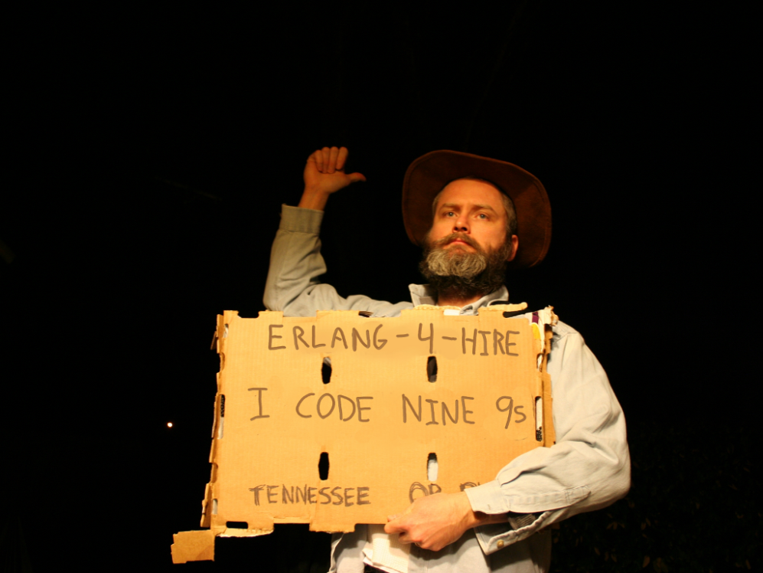
Nines | Uptime | Annual Downtime
9 | 99.9999999% | 30 milliseconds
8 | 99.9999990% | 300 milliseconds
7 | 99.9999900% | 3 seconds
6 | 99.9999000% | 32 seconds
5 | 99.9990000% | 5 minutes
4 | 99.9900000% | 53 minutes
3 | 99.9000000% | 8 hours, 46 minutes
2 | 99.0000000% | 3 days, 15 hours, 36 minutes
Safe
Supervisor
Worker
Worker
Links and monitors
No masters
Hot code loading
simple distribution, safe concurrency

Slide 41
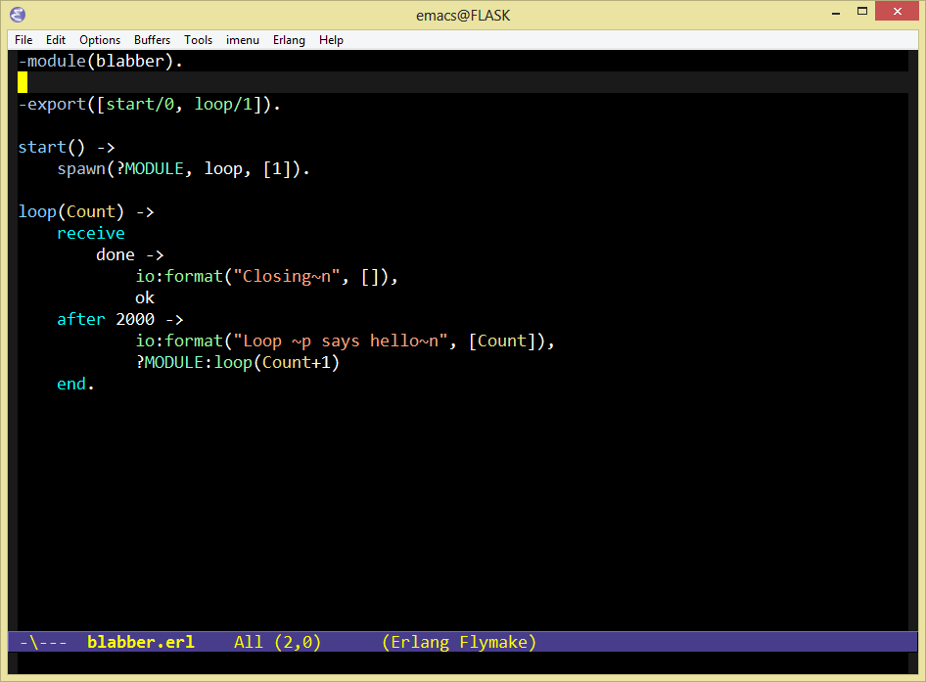

Slide 42
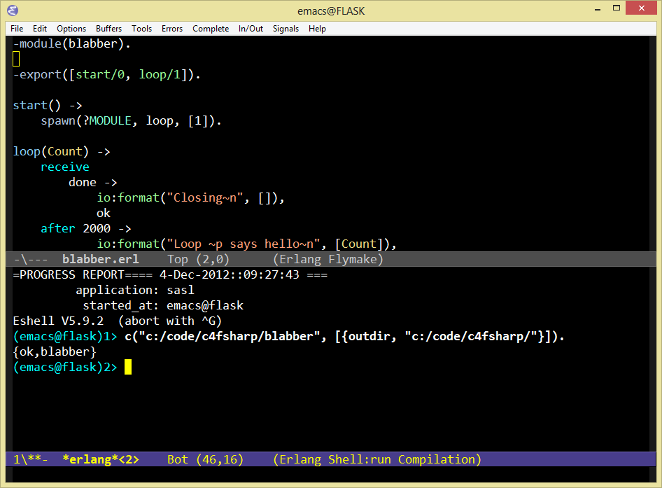

Slide 43
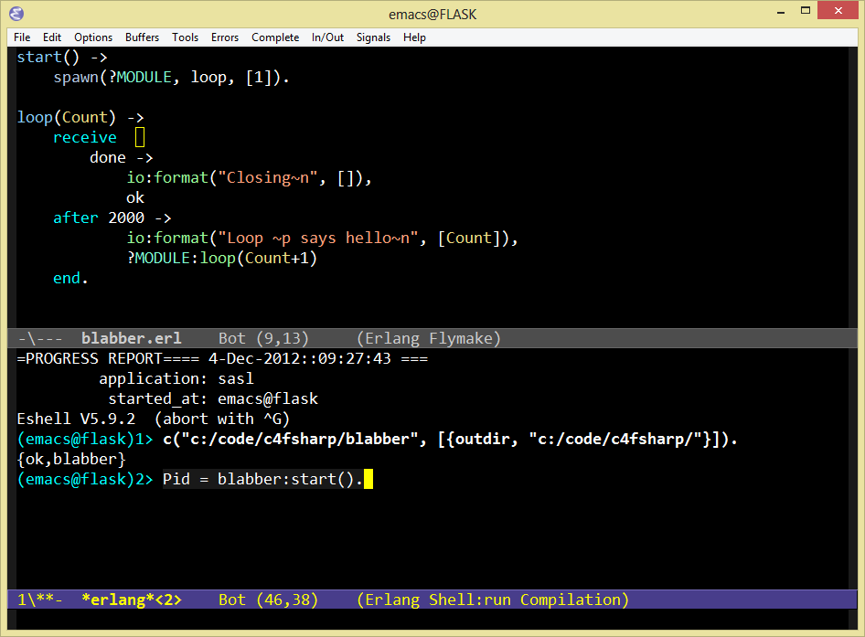

Slide 44
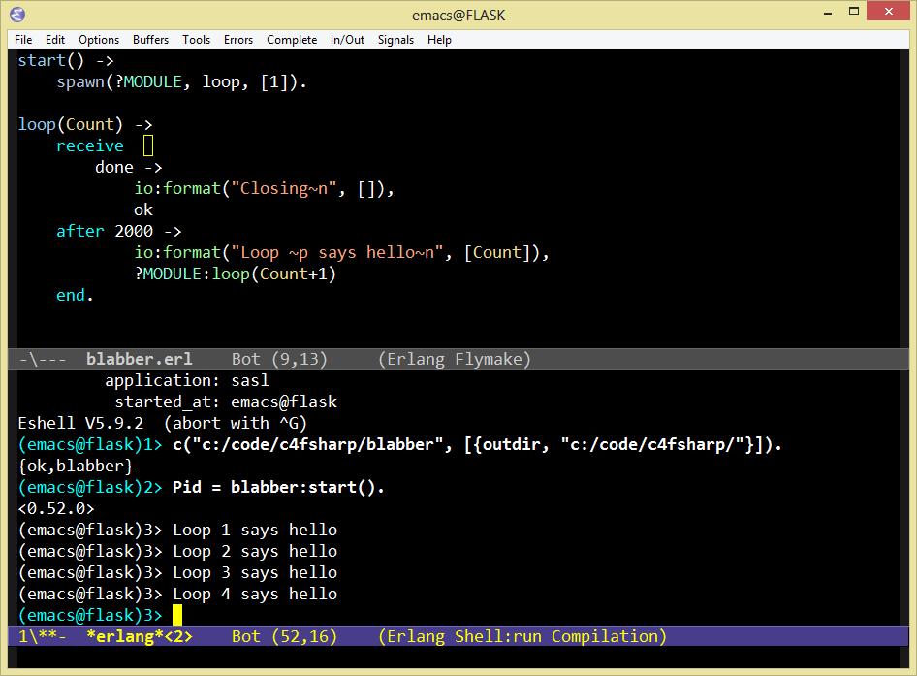

Slide 45
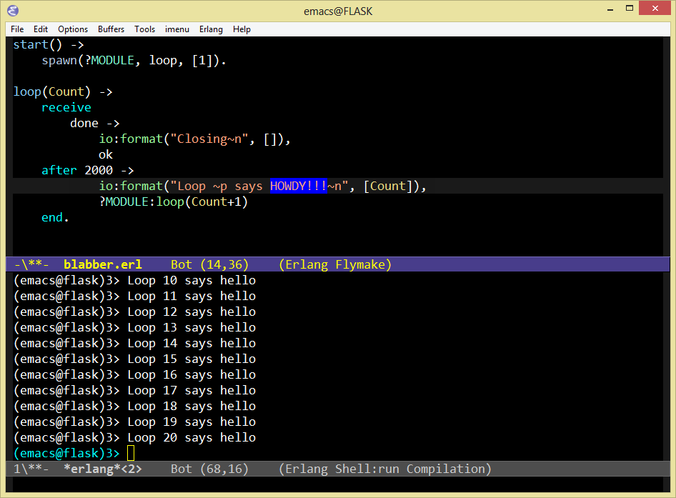

Slide 46
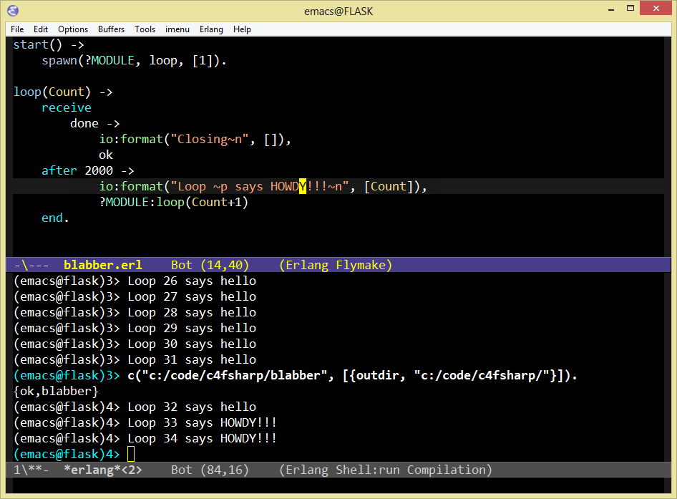

Slide 47
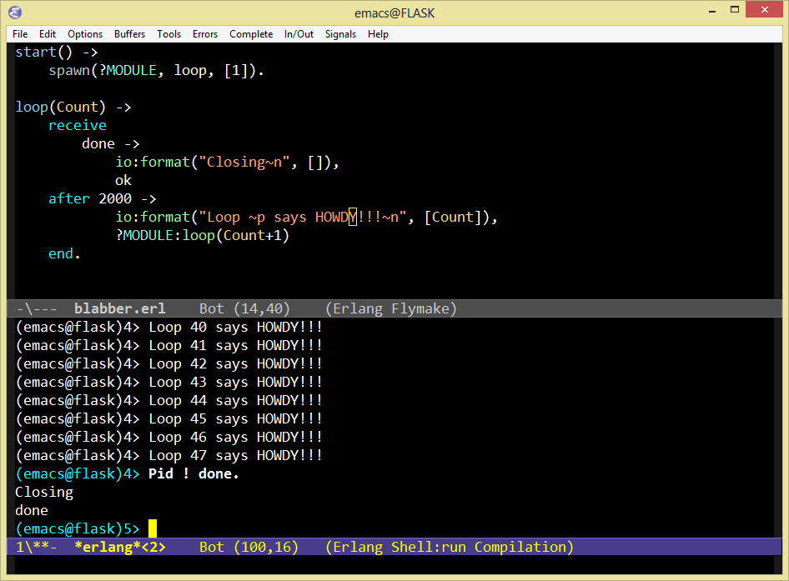

Slide 48
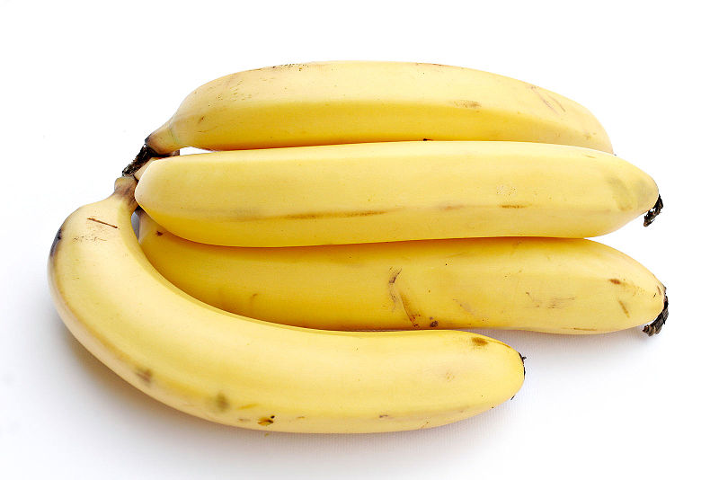
In OO, the “best” form of cohesion
is functional cohesion
“functional cohesion: is when parts
of a module are grouped because
they all contribute to a
single well-defined task.” –wikipedia (cohesion)

Slide 49
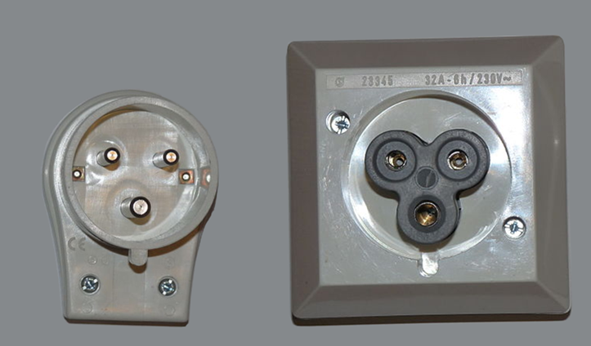
What are the best interop strategies?
You want me to do what!?

Slide 50
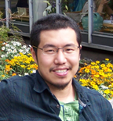
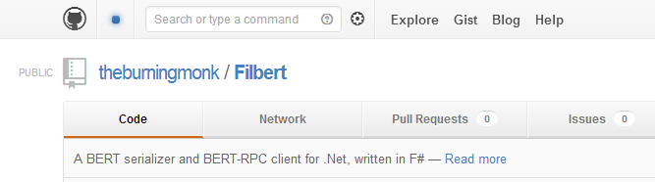
https://github.com/theburningmonk/Filbert

Slide 51
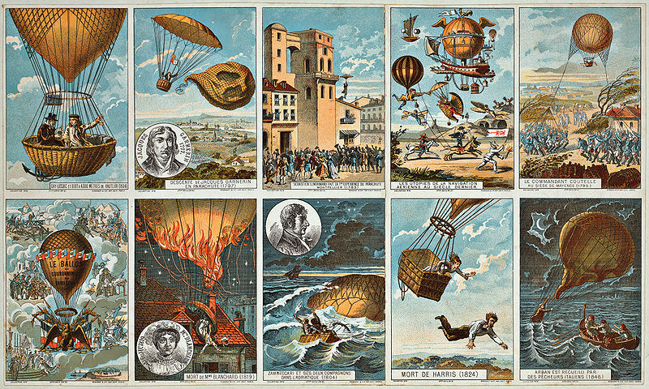
How to pilot Erlang?

Slide 52



http://joxa.org/
http://elixir-lang.org/
?
http://reia-lang.org/

Slide 53
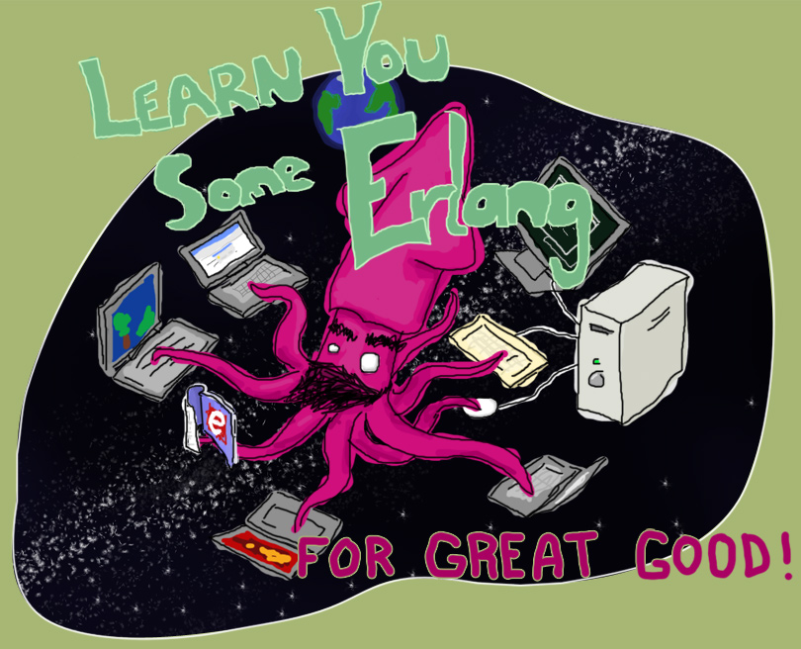
“Learn You Some Erlang for Great Good!” http://learnyousomeerlang.com/
How -> read this excellent and free online book

Slide 54



How -> read some books

Slide 55

Search “pragmatic kevin smith”
How -> code alongside Kevin Smith for eight screencasts

Slide 56
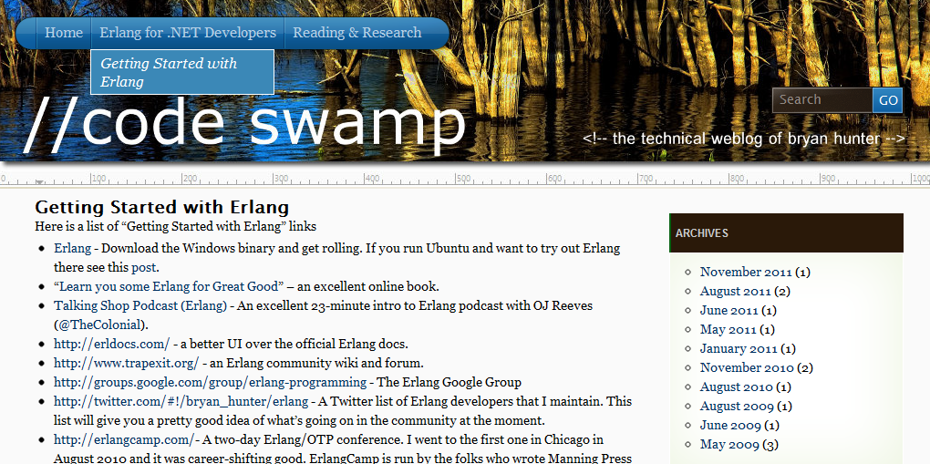
“Getting started” links, script to build Erlang from source on Ubuntu, ongoing screencasts of the Erlang tool-chain,
Info on the book-in-progress “Erlang for .NET Developers”
How -> visit my blog at http://www.codeswamp.com

Slide 57
NashFP Nashville Functional Programmers
http://nashfp.org/
How -> join (or create) your local FP group

Slide 58
Bryan Hunter
Twitter: @bryan_hunter
Email: bryan.hunter@fireflylogic.com
Blog: codeswamp.com
Firefly Logic, Inc.
1000 Main Street, Suite 201 Nashville, TN 37206
http://fireflylogic.com
How -> keep in touch

